Slide 1
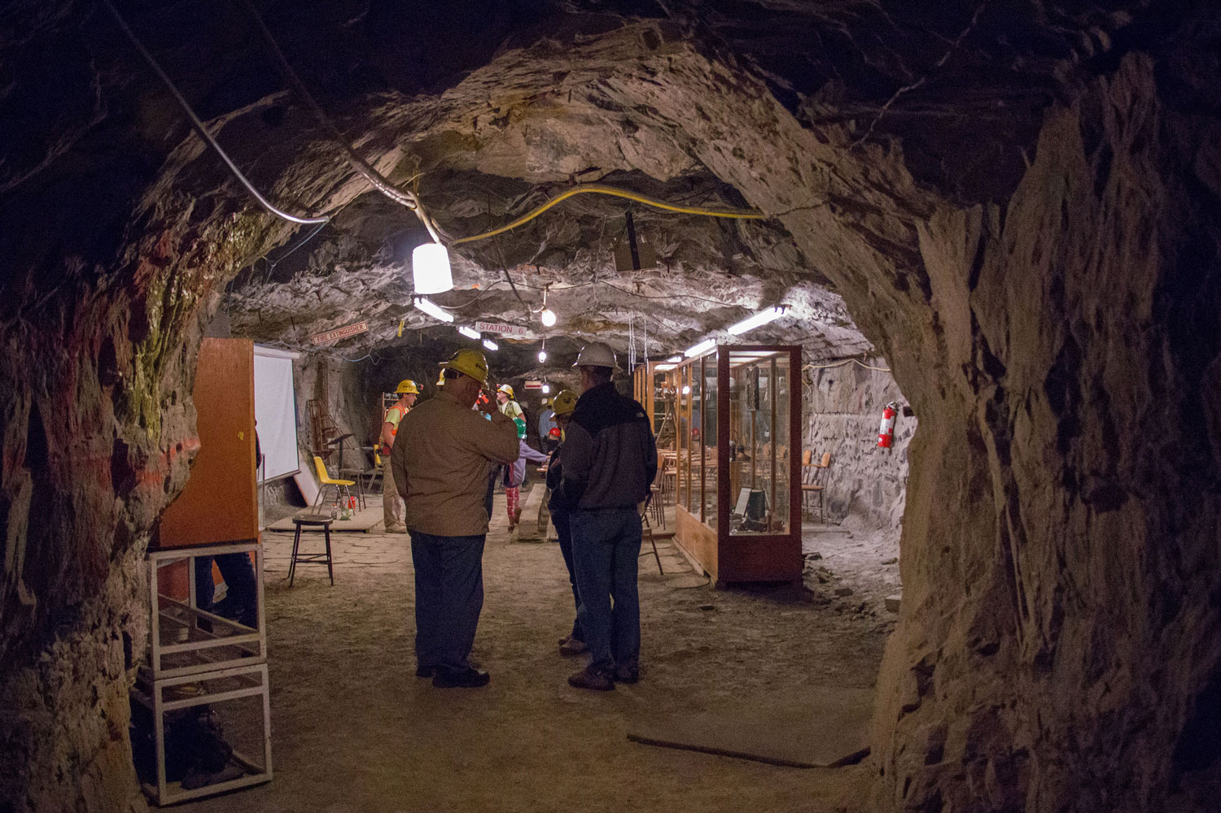
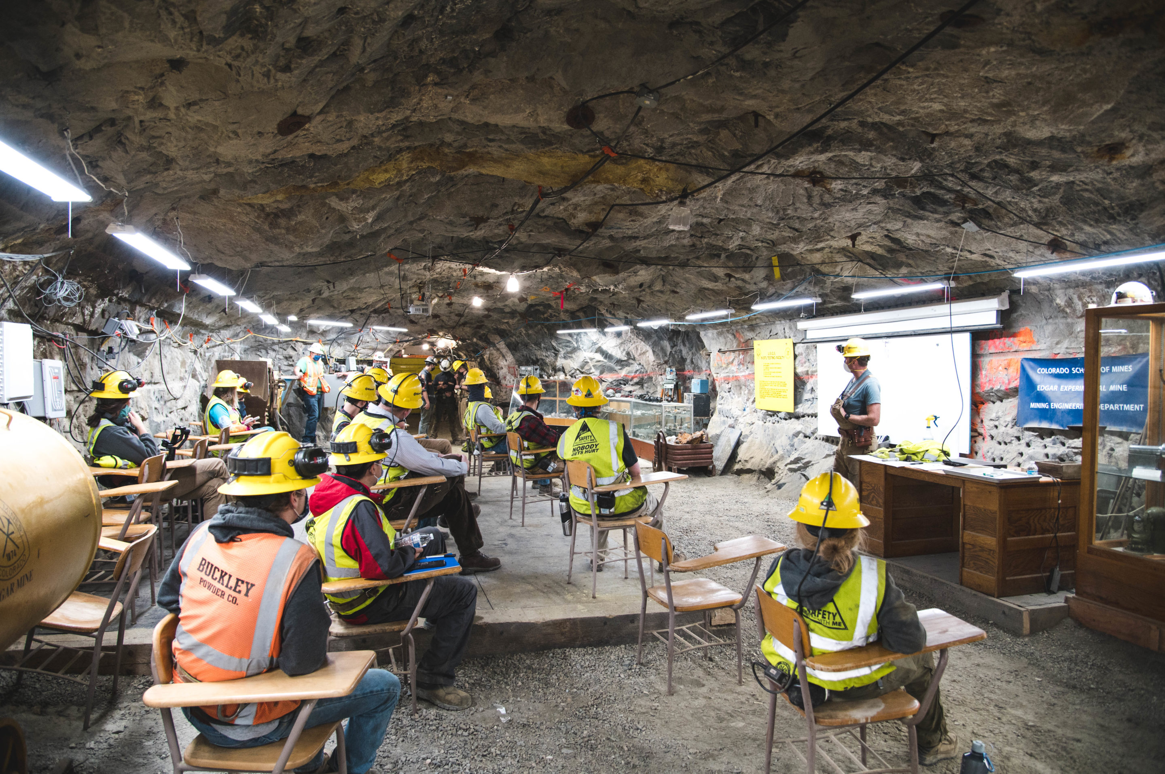
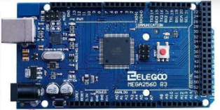
Proposed Remote Controlled Flowloop “Proto-type”: GPGN590 Team/Term Project
James Carmichael & Peiyao Li

Slide 2
Outline/Agenda:
Introduction
Primary Motivation
Production Logging
Current Setup within Mine
Implementation
Structure/Feasibility (recreation smaller scale)
Workflow (successes and failures)
Caution/Learnings
Pressure concerns
Electrical hazards
Future potential work/improvements
Testing configurations
Components/parts
Silly Straw config
Pressures

Slide 3
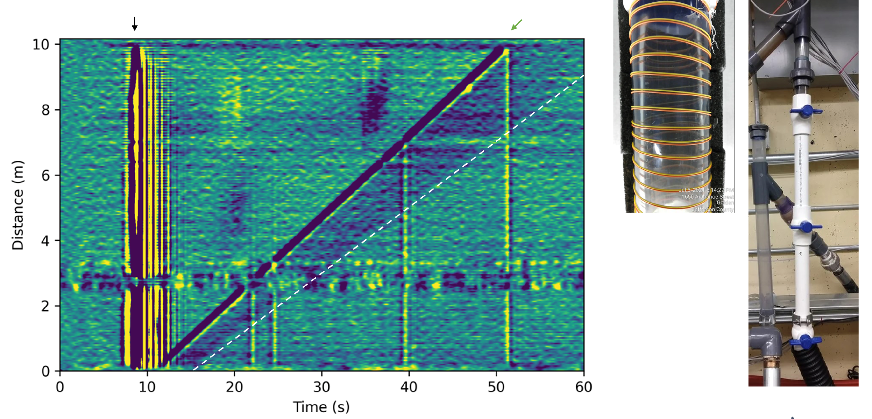
- Production Logging: wake region
Introduction
Fiber-Optic Distributed Acoustic Response, note the change in slope

Slide 4
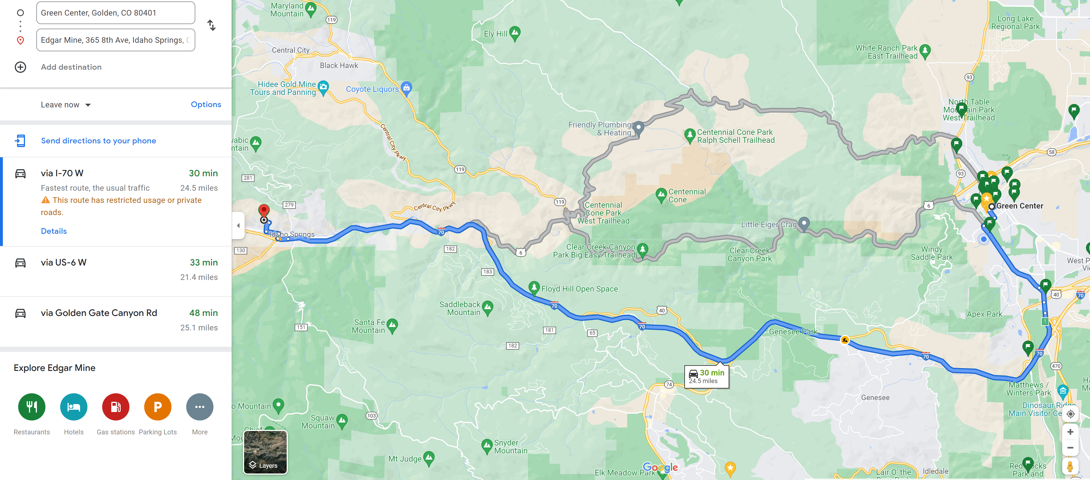
- Primary Motivation
Introduction
So, what will come from the instrumental design, is not direct geophysical measurements…
Provided is a list of problems this instrumental solution will resolve:
Important health & safety solution for when weather is hazardous:
heavy snow
ice
extreme winds
Reduction/removal of two-way travel-time:
from Mines campus or some other location to the site at the Mine
Saving of fuel costs used on research, to access the site.
Remote access allows alterations & testing even during nights, holidays or off-hours - when no personnel is on or allowed on site

Slide 5
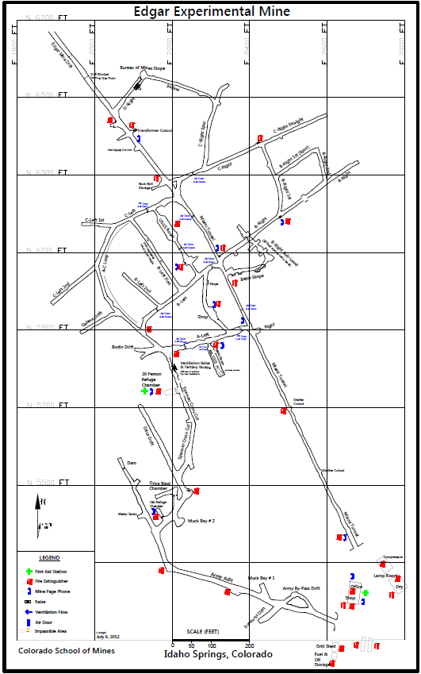
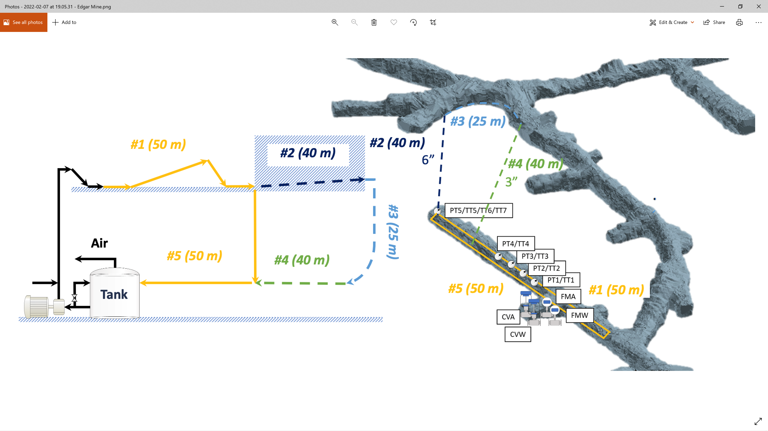
Current Large Scale
Edgar Mines’ Implementation
Main
Entrance

Slide 6
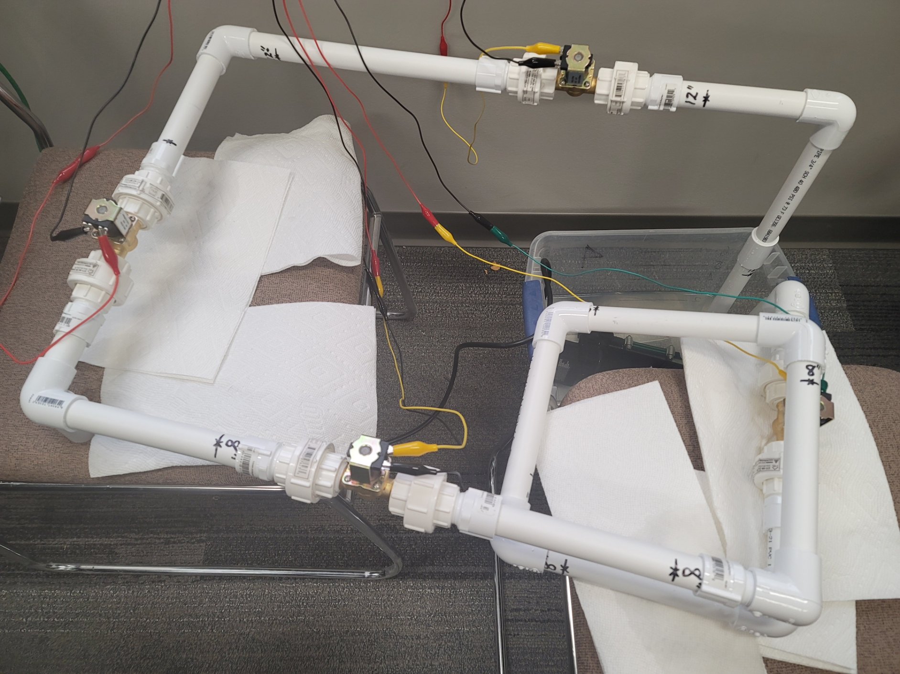
Miniaturization & recreation for lab scale – but still a loop!
Recently relocated, over across the hall
Conflicted with new shelving in corner
Benefit- improved cell network
Used for hotspot
Too many issues with MAC
address declaration in CSM-
wireless & IoT
Future potential to expand
While smaller, with use of pump
and small plastic tank, we are
reusing water, and pushing pressure
through valves

Slide 7
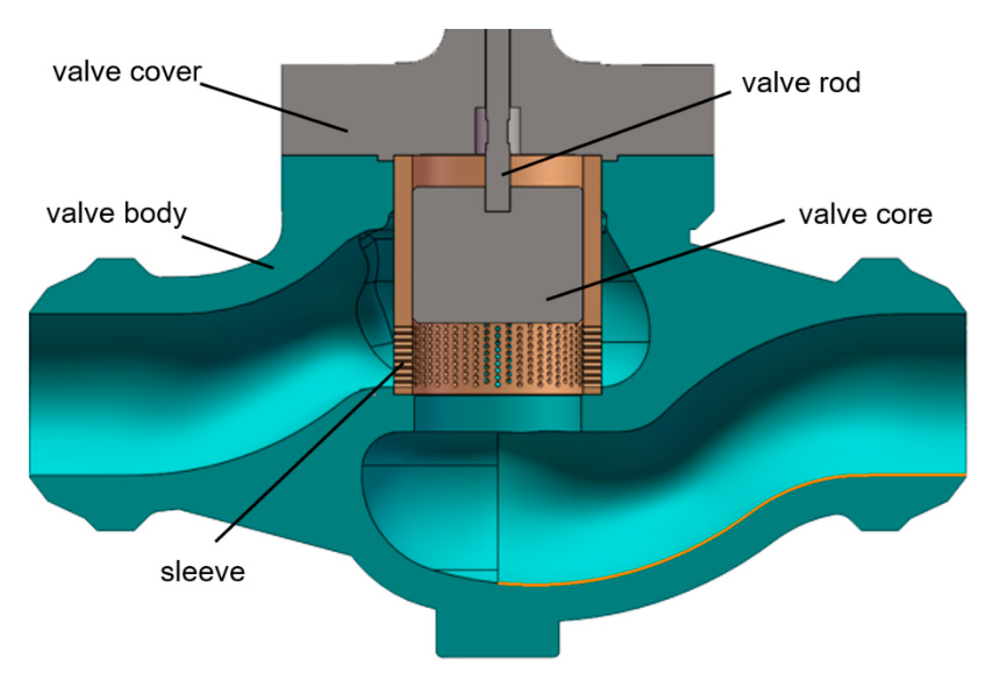
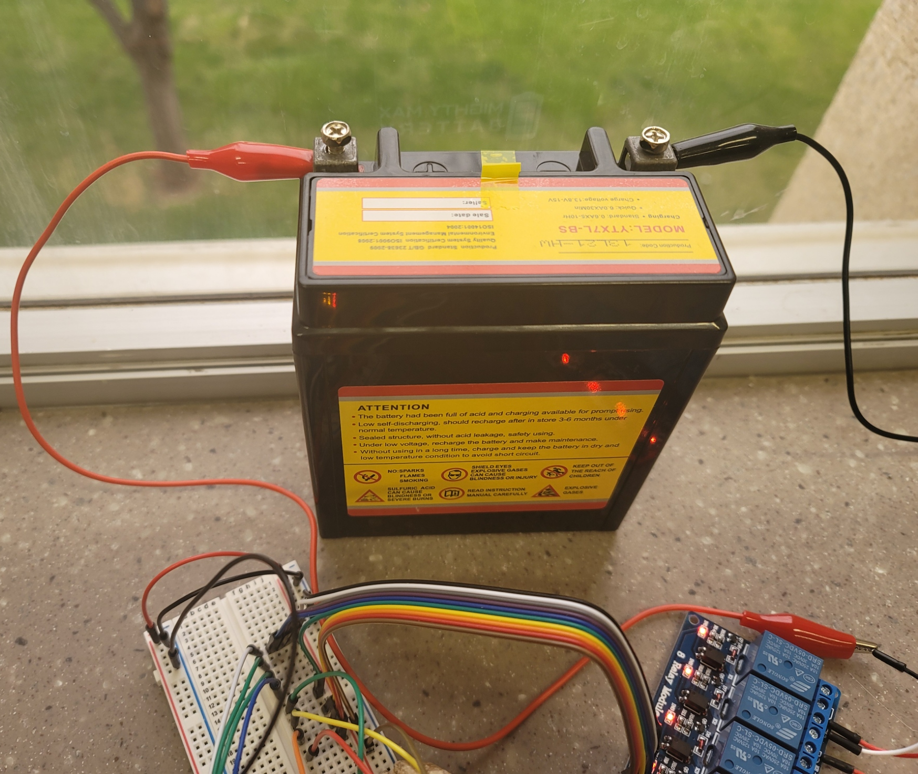
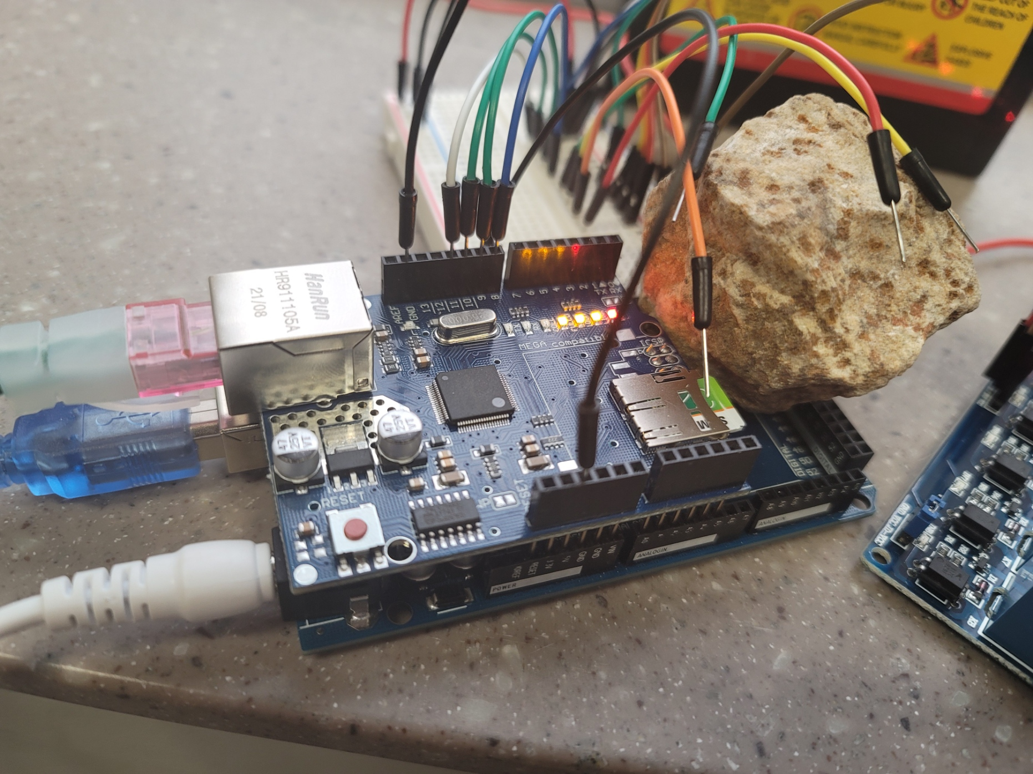
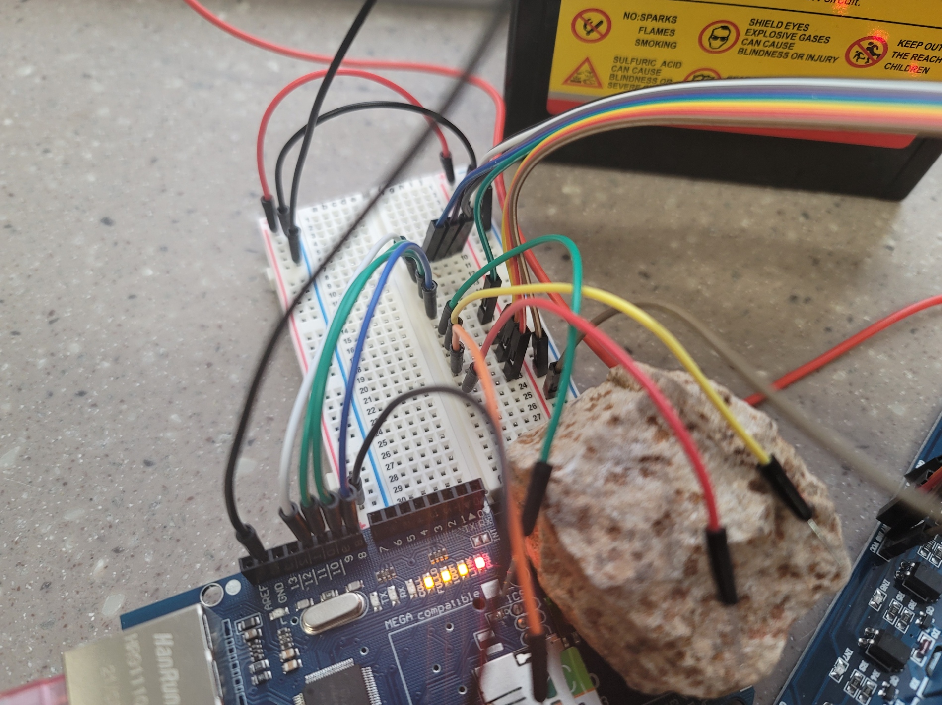
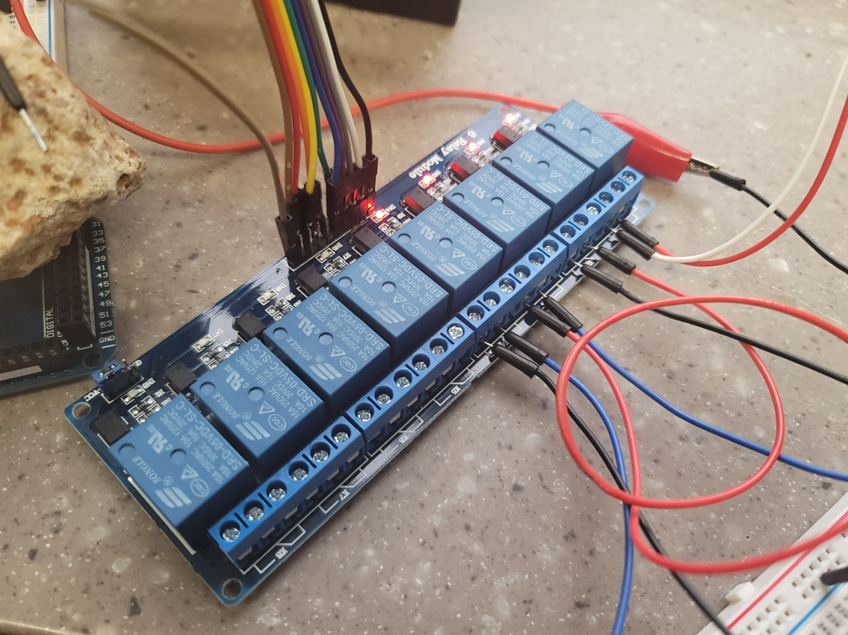
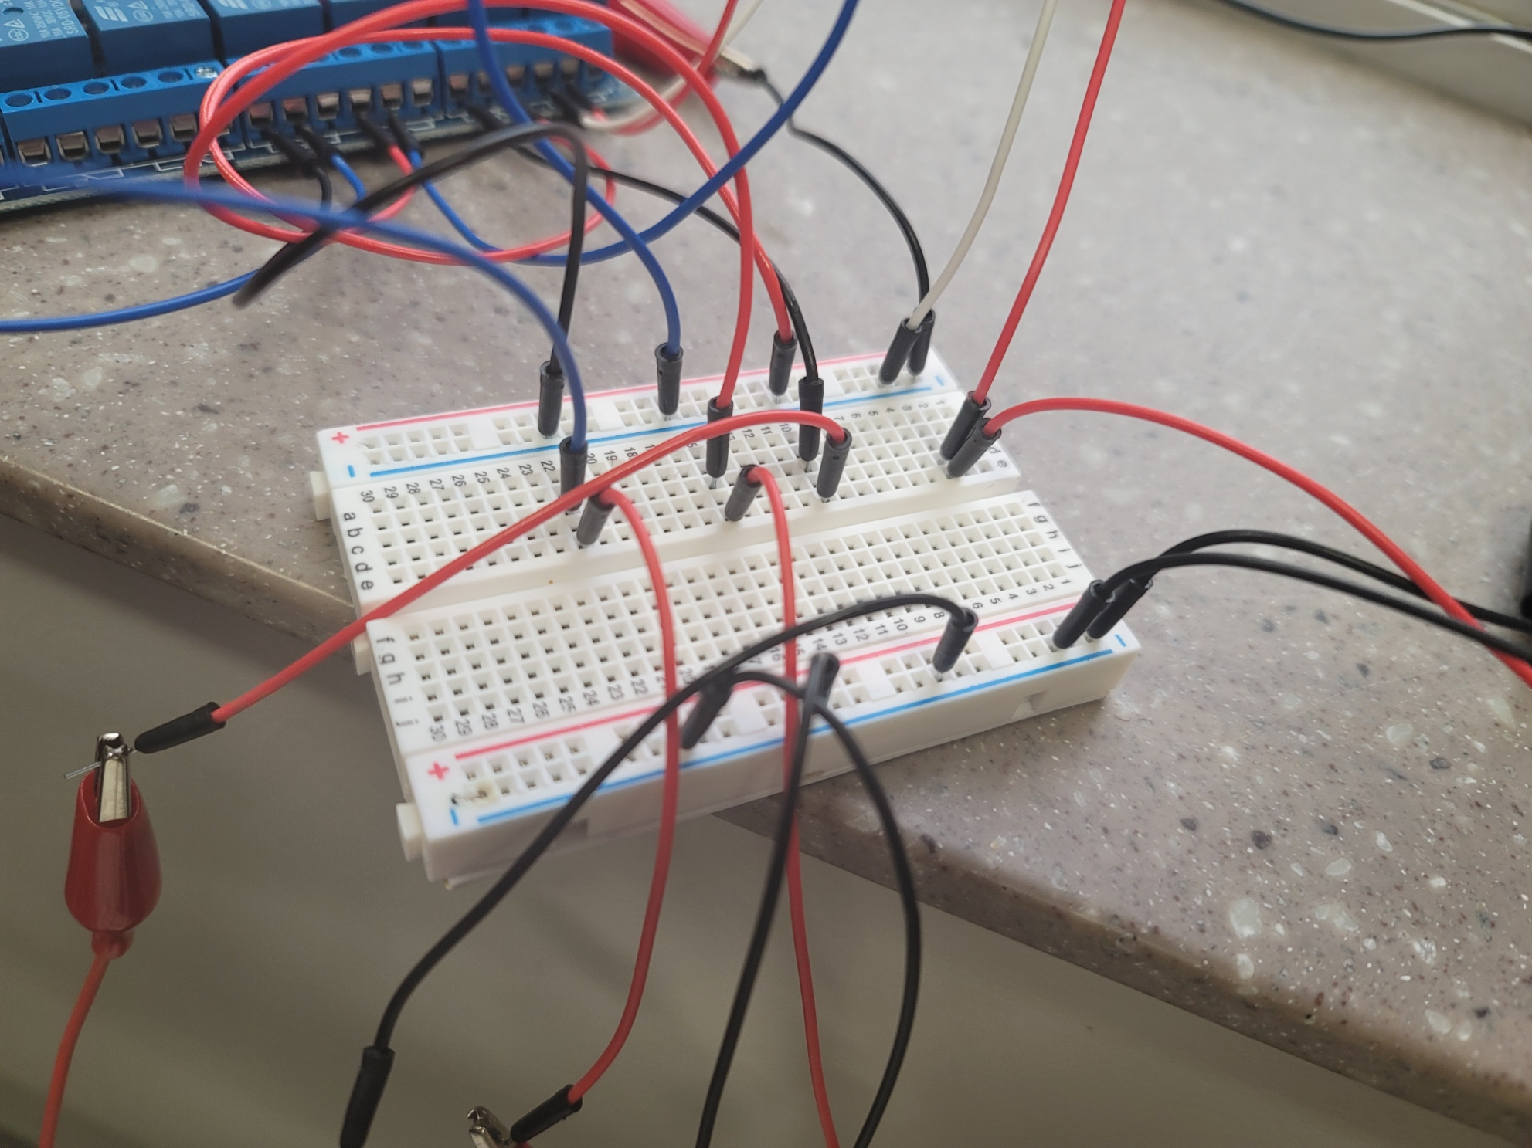
Full Setup includes:
Total System Approx. $250
Comparison to 5 trips in a single month!
to the mine, from campus
(Each round Trip ~$50)
1x Arduino Mega Board
1x Ethernet/LAN Shield
1x 8-relay board
2x mini-breadboards
1x 12V-motocycle battery (1x more as a backup)
Multitude of wires & clips to connect network up
4x smart valves
Over 5ft worth of 3/4inch pvc pipe
1x tank
1x pump – sufficient pressure (0.3psi / 12ft) to pump

Slide 8

Workflow (successes and failures)
SUCCESSES…
1) we setup a mini-flow loop
- consisting of 5+ft of pipe & 4-smart valves
2) after many trials figured out wiring of relay
3) setup a wireless method to control the opening and closing of the valves
Current code iterations all valves
simultaneously
Alternatively, delayed opening and
close for flow-rate control
BUT…

Slide 9
Workflow (trials and tribulations)
Some short comings:
Slightly leaky pipe network, plumbers' tape but no paste (partly so could make adjustments & dismantle at end, worked in our favor to allow for easy relocation)
12Volt battery and…
4-pin button/switches don’t mix
Just don’t try (hence the relay)
LEDs don’t mix
Unless extremely high resistors included & LED colors are not all made the same – Ex. busted red
Melted/smoked some wire
Who know a breadboard could be toasted
Many trips to HomeDepot
Initial
2nd for more pipe connections
3rd yet more pipe connections & pump connectors
4th in search of a strong pump
Water & Electricity dangerous combo,
we did find some occurrences of static shock nothing serious, we were safe and unplugged regularly in setup and testing phases

Slide 10
Caution/Learnings
Pressure concerns
Due to the lack of paste, the pressure of the pump and concerns over loose wires everywhere, now we have all valves set to all turn on or off simultaneously.
Future work would be modify the construction, use paste and reorganize wires to allow testing of higher pressures
Additionally, even smarter valves that allow varying flow rate and pressures to build
Electrical hazards
As mentioned, the wires are a concern
After the move, even one professor requested we push back the power extension further from water reservoir
Relocation did allow for battery to be on a different “plane” than pipe network so less concern of water and main power source interacting

Slide 11
Future potential work
While this implementation does allow for remote enable and disable of fluid flow within pipe network, other options include
Setup some T-intersections to reroute or allow air into system(?)
Even more valves, up to 8 limit of this one relay
Increase pump power
Install pressure meter(s) for quantitate control
Add multiple phases of fluid, such as:
Introduction of air
Introduction of mineral oil
Comes at a slight difference in reservoir tank…
Install DFOS (external & internal)

Slide 12
Future improvements…
Testing configurations
Components/parts
Different smart valves for gradient or gradational flow (not just on or off, 1 or 0, range)
Silly Straw config
While we have one nice smaller internal loop/spiral in network, we could do far more advanced or unique configurations
Undulation pipeline config for production test (different tilts)
Pressures
Unsure of what exactly the limit of the bits and parts we are currently using…

Slide 13
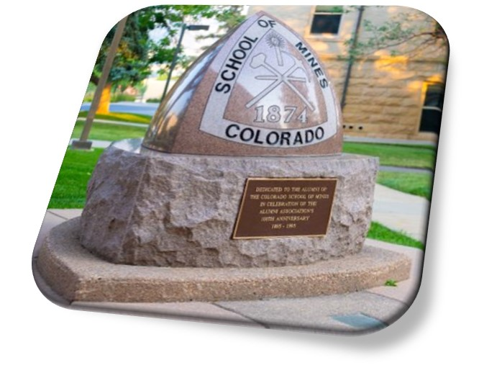
Thank you – Demo TIME!

Slide 14
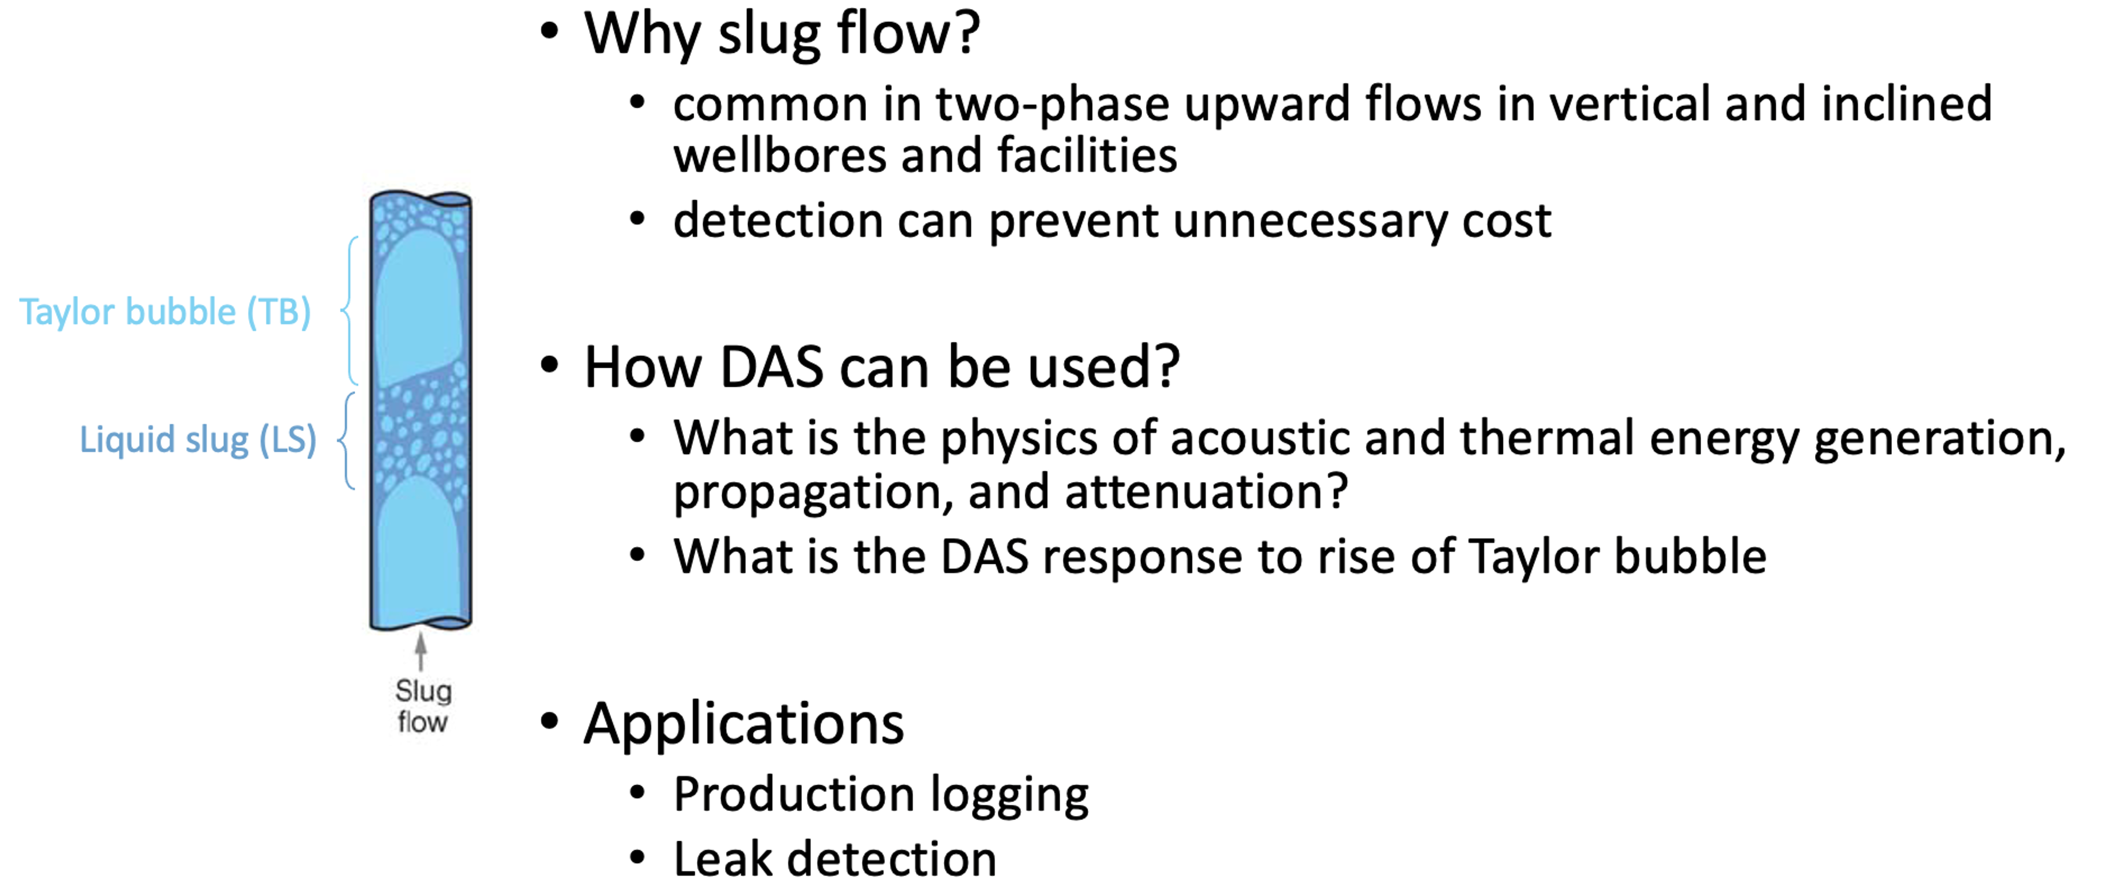
IntroSo…
What geoscience quantity you are aiming to measure / monitor?
What geoscience problem will this help you address?
Primary Project at play:

